Slide 1
NYSTRS’ Year in Review
& Long-Term Stability of the System
2024 Annual Delegates Meeting
Robin Wagner
Member Relations Representative

Slide 2
Year in Review
Feedback
Legislative Updates
System Financials
Board Elections

Slide 3

Year in Review

Slide 4


Slide 5


Slide 6
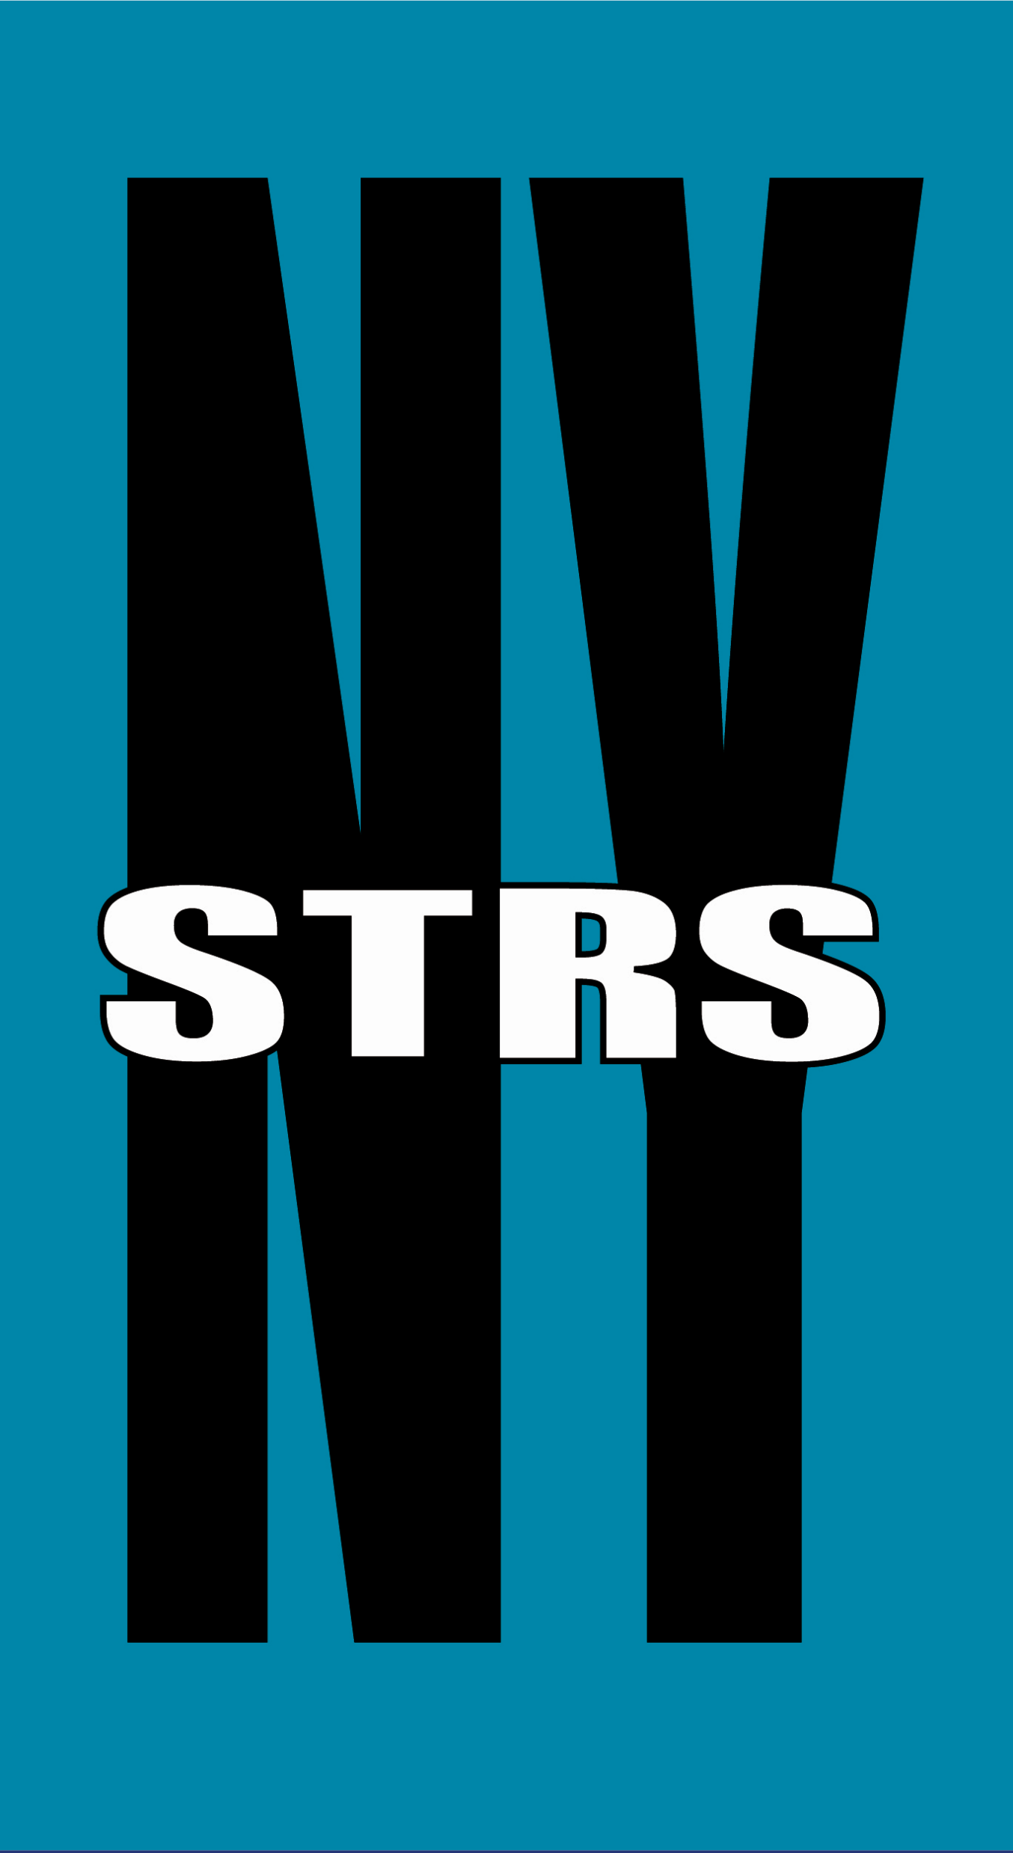

Slide 7
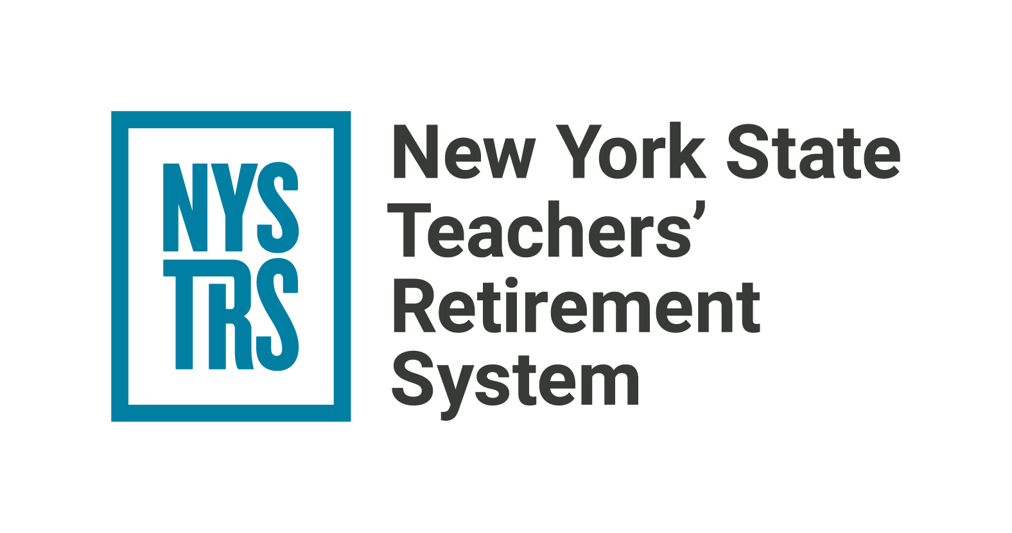

Slide 8
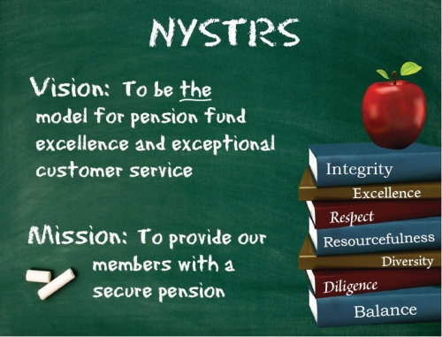

Slide 9

NYSTRS Benefits
Financial Planning
Social Security
Estate Planning
The Retirement Process

Slide 10

District and Special Group Presentations
New Member
General Benefits
Approaching Retirement
Retiree
In Person or Virtual
District representatives:
call David Costello at 518-447-4763.

Slide 11

Employer Reporting Trainings

Slide 12

Consultations

Slide 13

For the first time ever, the 2024 MWBE conference was held at the State University at Albany.
More than 200 attendees participated in the day-long conference!
Notes:
This past February The 14th annual Minority- and Women-Owned Business Enterprises was for the first time in history held at u Albany the conference featured sessions and booths designated to acquaint potential asset mangers and brokers with the system in addition to workshops hosted by NYSTRS staff including fixed income private equity and Public equities.

Slide 14

Ranked in the top 10 of retirement funds
The annual ranking by Pensions & Investments deemed NYSTRS the eighth largest defined benefit plan and the 10th largest retirement fund in the US.

Slide 15

Annual COLA Increase for Retirees
Eligible retirees received a 1.8% increase on
the first $18,000 of their pension benefit.
The maximum monthly increase is $27.00.

Slide 16

Board Member Elections

Slide 17
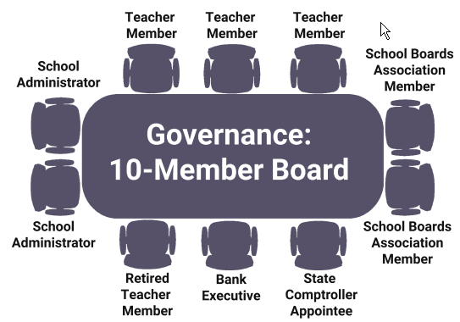

Slide 18

Board Member Elections
Eric J. Iberger
A teacher in the Bayport-Blue Point Union Free School District is the incumbent up for
re-election to serve the 2025-2028 term.

Slide 19

Board Member Elections
Donald A. Little III
A teacher in the Syracuse City School District is the incumbent to fulfill the remainder of the 2024-2027.

Slide 20

Feedback

Slide 21

Delegates Toolkit

Slide 22
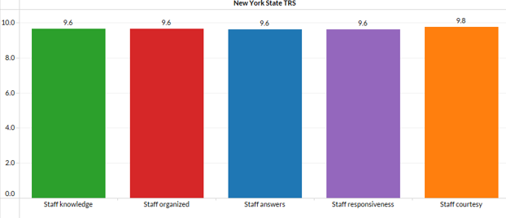
Cobalt Survey

Slide 23

Consultation
93.5% rated their consultation experience as excellent.
94.5% highly likely to recommend to colleagues.

Slide 24
Post Call Survey
Agents received an average score of 4.78 out of 5.
Caller satisfaction scores averaged 4.75 out of 5.

Slide 25
PREP Seminar
95.2% Rated the seminar as excellent.
96.5% Highly likely to recommend to colleagues.

Slide 26

Legislative Updates

Slide 27

Tier 6 Gets a 3-Year Final Average Salary (FAS)
Chapter 56 of the Laws of 2024
also changes Tier 6 FAS’s “look-back” requirements to mirror Tier 4 requirements.

Slide 28

3-Year FAS Limitations for Tiers 3-6
10% above the average of the previous two year’s salaries.

Slide 29
Earnings Limitations Example
Tiers 3-6
(Cannot exceed 10% increase over
the average of previous two years)
School Year Ending | Salary Earned | Salary Limitation
June 30, 2025 | $74,000
June 30, 2024 | $72,000
June 30, 2023 | $70,000
June 30, 2022 | $62,000
June 30, 2021 | $60,000
$ 62,000
+ $ 60,000
$ 122,000 / 2
$ 61,000
x 1.10
$ 67,100
$72,000 Average

Slide 30
Earnings Limitations Example
Tiers 3-6
(Cannot exceed 10% increase over
the average of previous two years)
School Year Ending | Salary Earned | Salary Limitation
June 30, 2025 | $74,000 | $78,100
June 30, 2024 | $72,000 | $72,600
June 30, 2023 | $70,000 | $67,100
June 30, 2022 | $62,000
June 30, 2021 | $60,000
Final Average Salary: $ 71,033

Slide 31

Two-year Extension of
Chapter 56 of the Laws of 2022
Tier 6 employee contribution rate for the two fiscal years ending
June 30, 2025 and June 30, 2026 will be based solely on a member’s annual base wages.

Slide 32
Tier 6 Contribution Rate
Tier 6 Contribution Chart
Salary | Contribution Rate
$45,000 and less | 3.0%
More than $45,000 to $55,000 | 3.5%
More than $55,000 to $75,000 | 4.5%
More than $75,000 to $100,000 | 5.75%
More than $100,000 to Maximum of NYS Governor’s Salary | 6.0%
Current NYS Governor's Salary: $250,000

Slide 33
Example of Impact
2024-2025 Earnings
Annual Base Pay Rate | $72,000
Coaching Salary | $ 8,000
Total Earnings | $80,000
Without Chapter 56
2027 Contribution Rate
5.75%
With Chapter 56:
2027 Contribution Rate
4.5%

Slide 34

One-Year Extension of
Chapter 55 of the Laws of 2023
NYSTRS retirees can earn unlimited compensation in a position with a New York State public school or BOCES without suspension of their retirement allowance from:
April 9, 2022 - June 30, 2025.

Slide 35

Pending Legislation

Slide 36
Earlier Recalculation Under Section 503.11
Amends Section 503 (Subdivision 11) of Education Law to allow a NYSTRS
retiree restored to active service
the option to elect a full recalculation
after 2 years of service credit.
Previously, 5 years of service was required.

Slide 37

System Financials

Slide 38
Member Life Expectancy in Years
Retirement Age | 55 | 65 | 75 | 85 | 95
Years in Retirement (Female) | 34.9 | 25 | 15.7 | 8.2 | 3.5
Years in Retirement (Male) | 32.4 | 22.6 | 13.7 | 7.0 | 3.1

Slide 39
Advance Funding
NYSTRS:
Invests the employer and member contributions throughout a member’s career; and
Accumulates the assets necessary to provide a fully- funded benefit in retirement.

Slide 40

Long-Term Rate of Return
6.95%
30 Year
Long-Term Rate of Return

Slide 41
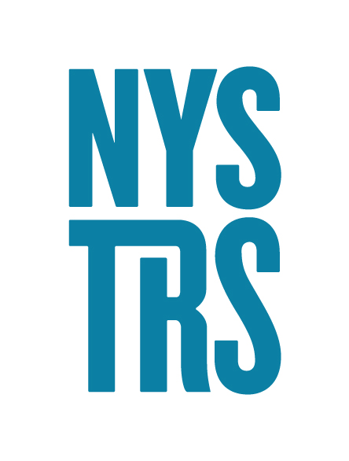
Thirty Year Asset Summary 1994-2024
Employer Contributions
$34.8 billion
Member Contributions $5.0 billion
Investment Income $220.3 billion
Benefit Payments and Expenses $154.5 billion
Approximate Market Value of Assets - 1994: $ 40.3 B
Approximate Market Value of Assets - 2024: $145.8 B
Notes:
.

Slide 42
Long-Term Annualized Rates of Return
Period | Rate of Return (Net of Fees)
1-Year | 11.4%
5-Year | 8.5%
10-Year | 7.8%
15-Year | 9.8%
20-Year | 7.8%
25-Year | 6.7%
30-Year | 8.7%
As of June 30, 2024

Slide 43
Market Value of Assets
As of: | Market Value of Assets (in Billions)
June 30, 2020 | $120.5
June 30, 2021 | $148.1
June 30, 2022 | $132.0
June 30, 2023 | $137.2
June 30, 2024 | $145.8
Five-Year Period 2019 – 2024 (in Billions)
Benefit Payments and Expenses | Employer Contributions Collected | Member Contributions Collected
$40.3 | $8.6 | $1.0

Slide 44
Asset Allocation
As of June 30,2024
Notes:
I know growing up I was always told not put my eggs all in one basket and that is kind of the country way of explaining diversification. Asset allocation is the most significant tool that we use in managing the pension Funds Long term Investment performance. Diversification means owning a variety of assets that perform differently over time. Because assets perform differently in different economic times, diversification smoothens your returns and help mitigate risk and volatility. NYSTRS Retirement Board reviews the asset allocation policy on an annual basis. The allocation process allows us to achieve the highest possible returns while controlling the level of risk. And it results in the lowest possible costs to employers and New York State taxpayers.

Slide 45
Sources of Income: 30 Years
NYSTRS
7/1/1994 - 6/30/2024

Slide 46
NYSTRS Funded Ratios*
Actuarial Value of Assets – the average (or smoothed) investment return over a period; NYSTRS uses a 5-year smoothing calculation.
99%
Market Value of Assets – the current price for which you could sell the System’s assets on the open market.
101%
* Estimated as of 6/30/2024

Slide 47
Employer Contribution Rate
2024-2025 Rate is 10.11%
2025-2026 Estimated to be between 9.5% – 10%

Slide 48


Slide 49
