Slide 1
Social Security: What Should You Know?
Christine Wade
Information & Communication Center
2024 Annual Delegates Meeting

Slide 3
Typical Questions:
How do I qualify for benefits?
How is my benefit calculated?
When should I start collecting?
Are Social Security benefits taxed?
How do I apply for benefits?

Slide 4
Will Social Security benefits be there for me?

Slide 5
Why are Americans Concerned?
Social Security is a pay-as-you-go plan
Retiree population is growing
Working population is shrinking
Taxes collected currently are not sufficient
Reserves are being utilized to pay benefits

Slide 6
Trust Funds are Running Low

Slide 7
How do I qualify for benefits?

Slide 8
Qualify for Social Security Retirement
As you work and pay Social Security taxes, you earn Social Security credits.
Credits are based on your annual earnings
You may earn up to four credits in any year
You need 40 credits (10 years of work)

Slide 9
Social Security Payroll Taxes
Federal Insurance Contributions Act (FICA)
7.65% tax you pay on gross wages
6.2% to fund Social Security
1.45% to fund Medicare
“Maximum taxable earnings” amount changes annually
6.2% is matched by your employer; the self-employed pay 12.4% of net earnings

Slide 10
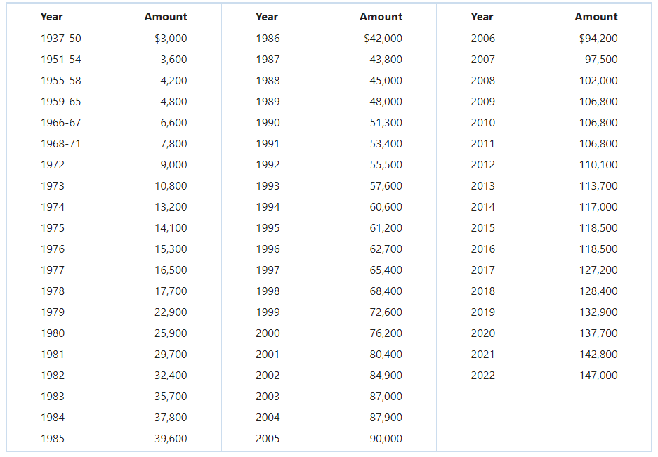
Maximum Taxable Earnings
2023 160,200
2024 168,600
2025 176,100

Slide 11
How is my benefit calculated?

Slide 12
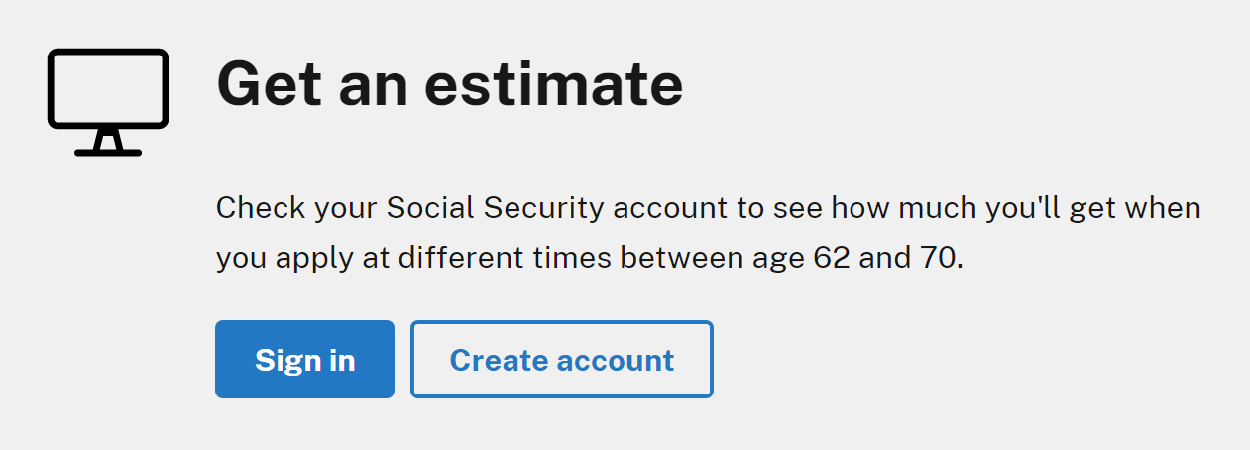
Retirement Benefit Calculation

Slide 13
Retirement Benefit Calculation
Multi-step progressive formula to determine and replace a percentage of your average monthly earnings based on your:
Lifetime earnings, and
Age at the time you claim benefits

Slide 14
Average Indexed Monthly Earnings (AIME)
Social Security Administration (SSA) will:
Adjust or "index" earnings through the year you turn 59;
Then, add up your 35 highest years of indexed earnings; and
Divide that figure by 420 (i.e., the number of months in 35 years).
The result is your Average Indexed Monthly Earnings (AIME) – or the average monthly income you had over the course of your career.
2025 Maximum AIME: $13,689

Slide 15
Primary Insurance Amount (PIA)
If you first became eligible for Social Security retirement benefits in 2025 by reaching age 62, your PIA would be the sum of:
90% of the first $1,226 of your AIME, plus
32% of your AIME over $1,226 and through $7,391, plus
15% of your AIME over $7,391
AIME:$1,167 ($14,000 annually)
PIA replaces about 90% of AIME
$1,050.30
$1,050.30

Slide 16
Primary Insurance Amount (PIA)
If you first became eligible for Social Security retirement benefits in 2025 by reaching age 62, your PIA would be the sum of:
90% of the first $1,226 of your AIME, plus
32% of your AIME over $1,226 and through $7,391, plus
15% of your AIME over $7,391
AIME:$9,500 ($114,000 annually)
PIA replaces about 36% of AIME
$1,103.40
$1,972.80
+ $ 316.30
$3,392.50

Slide 17
Primary Insurance Amount (PIA)
PIA is the benefit you would receive if you claim the benefit at your full retirement age.
Your monthly retirement benefit may be higher or lower.

Slide 18
Full Retirement Age
Year of Birth | Full Retirement Age
1937 and prior | 65
1938 | 65 and 2 months
1939 | 65 and 4 months
1940 | 65 and 6 months
1941 | 65 and 8 months
1942 | 65 and 10 months
1943-54 | 66
1955 | 66 and 2 months
1956 | 66 and 4 months
1957 | 66 and 6 months
1958 | 66 and 8 months
1959 | 66 and 10 months
1960 and later | 67
Persons born on January 1 of any year should refer to the normal retirement age for the previous year.
Year of birth determines your Full Retirement Age (FRA)

Slide 19
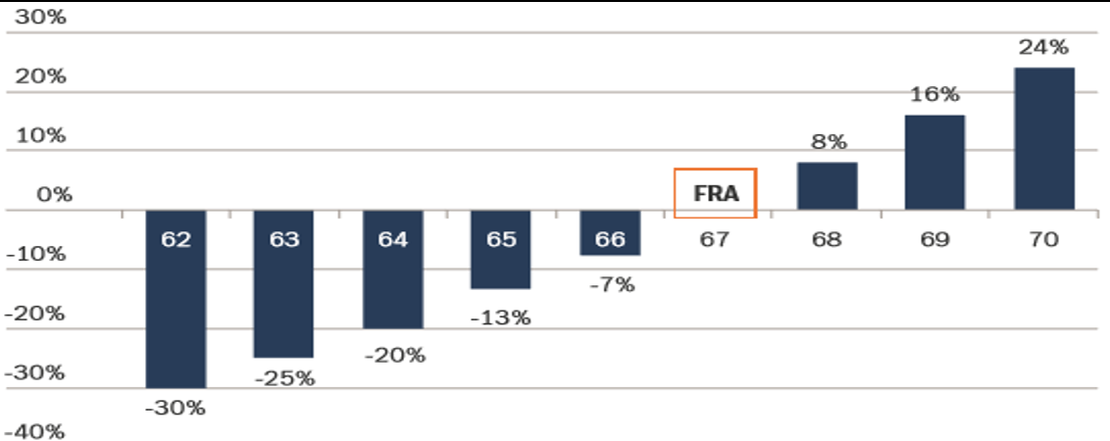
Monthly Benefit Amounts Differ Based on the
Age You Decide to Start Receiving Benefits

Slide 20
When should I start collecting?

Slide 21
Considering “Reduced” Benefits
“Should I wait to collect and receive a higher amount, or collect earlier and receive a lower amount for a longer period?”
Age 67 (PIA/FRA)
Age 62 (30% Reduction)
$ 2,000 per month
X 12 months
$24,000 annual benefit
$ 1,400 per month
X 12 months
$ 16,800 annual benefit
The difference between the annual benefits is $7,200 per year.

Slide 22
Determining the Break-Even Age
If I decided to collect at age 62, potential benefit from age 62 to 67 would be $16,800 x 5 years = $84,000
My benefit at age 67 would be $7,200 more per year
Once I start collecting at age 67, I would need to collect for at least 11 years – 8 months to break even on the money that could have been collected in those 5 years*
*Doesn’t account for potential COLA
$ 84,000
÷ $ 7,200
11.66

Slide 23
Benefits are Adjusted for Inflation
To preserve the buying power of your Social Security income, payments are adjusted for inflation through an annual Cost-of-Living-Adjustment (COLA).
Each year, the COLA is determined based on the percentage increase in the Consumer Price Index for Urban Wage Earners and Clerical Workers (CPI-W) from the third quarter of the previous year to the third quarter of the current year.
If there is no increase in the CPI-W, there will be no COLA for that year.

Slide 24
Benefits are Adjusted for Inflation
COLA increases are applied to benefits that are currently paid and to those that have not yet been claimed.
Year | COLA Increase |  | Year | COLA Increase
2025 | 2.5% |  | 2020 | 1.6%
2024 | 3.2% |  | 2019 | 2.8%
2023 | 8.7% |  | 2018 | 2.0%
2022 | 5.9% |  | 2017 | 0.3%
2021 | 1.3% |  | 2016 | 0 %

Slide 25
Additional Factors to Consider
Will family members qualify for benefits on your record?

Slide 26
Family Benefits
If you are collecting Social Security benefits, your qualifying spouse and/or child may each receive a monthly payment of up to one-half of your PIA.
Under age 18 (under 19 if still in high school)
Disabled before age 22
Spouse
Age 62+
Any age if caring for your child under age 16 or disabled
Unmarried Child

Slide 27
Spousal Benefits
The maximum spousal benefit is one-half of your PIA.
If your spouse qualifies for benefits on their own record, they receive their benefit first.
If the spousal benefit is higher, your spouse will receive an additional amount from your record, so that the combination of the two benefits equals that higher amount.
If your spouse begins receiving benefits between age 62 and their own full retirement age, your spouse’s benefit will be permanently reduced.

Slide 28
Survivor Benefits
After you pass, an eligible spouse and/or child can receive Social Security benefits based on your work record.
Under age 18 (under 19 if still in high school)
Disabled before age 22
Spouse
Age 60+
or 50+ if disabled
Any age if caring for child under age 16 or disabled
Unmarried Child

Slide 29
Factors to Consider
Will family members qualify for benefits on your record?
How is your health, and your family’s health history?
Do you have other retirement income to support you if you decide to delay receiving your benefits?
Are you eligible for benefits on someone else’s record?
Are you still working?

Slide 30
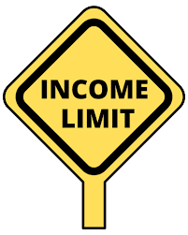
Earnings Limitation
If you collect Social Security retirement benefits and have not yet reached your full retirement age, Social Security imposes a limitation on your earnings.

Slide 31
Earnings Limitation
For those collecting Social Security who have not reached the year of their full retirement age, the 2025 limit on earnings:
$23,400/yr.
$1 in Social Security benefits is withheld for every $2 in earnings above this limit

Slide 32
Earnings Limitation
Annual Earnings |  | $26,400
Earnings Limitation | - | $23,400
Over the Limitation |  | $ 3,000
 | ÷ | 2
Benefit Withheld | = | $ 1,500

Slide 33
Earnings Limitation
For those collecting Social Security who have not reached the year of their full retirement age, the 2025 limit on earnings:
$23,400/yr. ($1,950/mo.)
$1 in Social Security benefits is withheld for every $2 in earnings above this limit

Slide 34
Adjustment of the Reduction Factor

Slide 35
Adjustment of the Reduction Factor

Slide 36
Earnings Limitation
The earnings limit for workers reaching their full retirement age in 2025
$62,160/yr. ($5,180/mo.)
$1 in Social Security benefits is withheld for every $3 in earnings above this limit

Slide 37
Earnings Limitation
There is no limit on earnings for workers who are their full retirement age or older for the entire year.

Slide 38
Are Social Security benefits taxed?

Slide 39
Your Benefits may be Taxed
Most states do not tax Social Security benefits.
New York does not tax Social Security benefits.
Retired Public Employees Association (rpea.org)

Slide 40
Your Benefits may be Taxed
Up to 85% of your benefit may be federally taxable, depending on your total combined income.
“Combined income” is the sum of your adjusted gross income, plus nontaxable interest, plus half of your Social Security benefits.

Slide 41
Taxing Social Security
Combined income determines potential taxability.
Individual Return | Joint Return | May be Taxable
Under $25,000 | Under $32,000 | 0%
$25,000 - $34,000 | $32,000 - $44,000 | Up to 50%
Over $34,000 | Over $44,000 | Up to 85%

Slide 42
Getting Information
Call (800) 772-1213
Speak to a representative
Use touch tone to access information
Representatives are available weekdays (8 a.m. - 7 p.m.)
Visit a local Social Security office
Verify ability to visit and/or book an appointment

Slide 43
Getting Information
Utilize the website: ssa.gov
Download publications
Generate calculations: ssa.gov/estimator
Review latest COLA’s, earning limitations, etc.
Register for your account

Slide 44
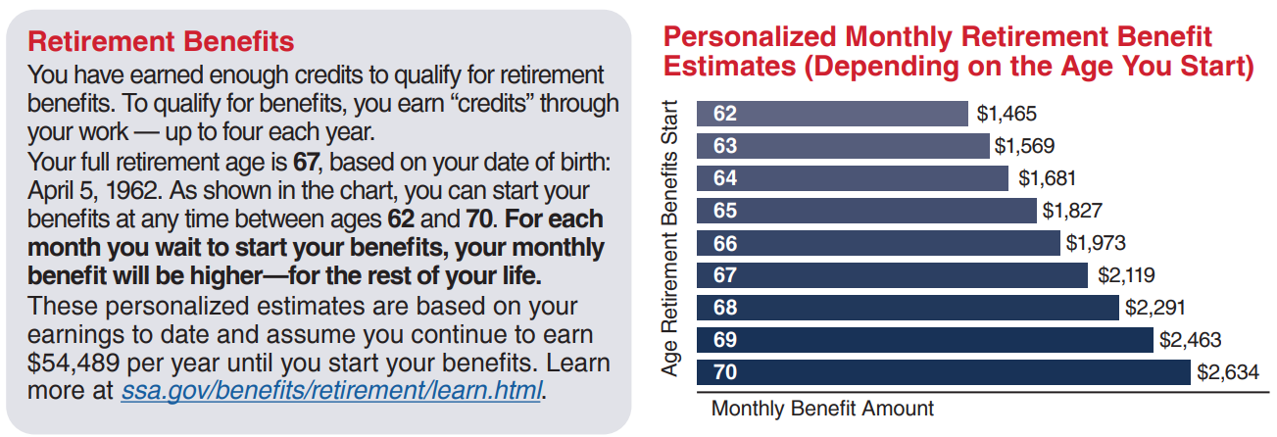
Social Security Statement

Slide 45
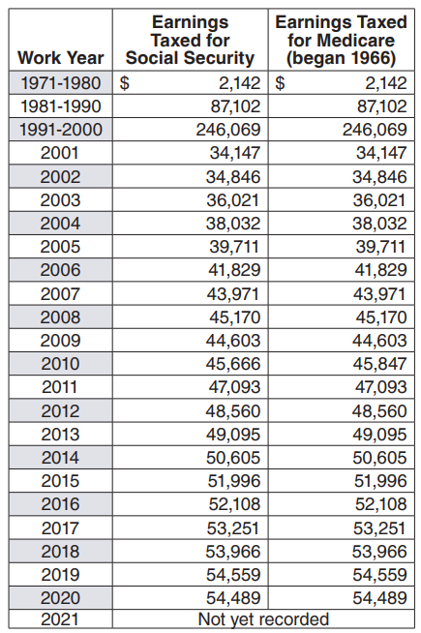
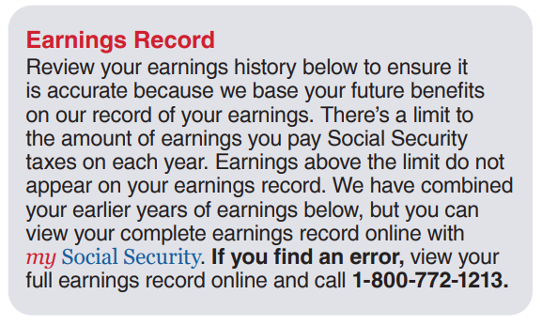
Social Security Statement

Slide 46
How do I apply for benefits?

Slide 47
Apply for Benefits
You can apply up to 4 months prior to benefit start date:
In person at a local office (appointments recommended)
By telephone (800) 772-1213
Online: ssa.gov/apply

Slide 48
You Should Know:
Choosing when to collect Social Security retirement benefits has significant financial impact.
Utilize the tools and resources available
Evaluate your options
Consult with a professional

