Slide 1
Disability and Death Benefits
2024 Annual Delegates Meeting
Nicole Macygin
Member Relations Representative
Notes:
Good Afternoon Everyone, I hope you have enjoyed this years delegates meeting so far and got a lot out of all the programing and enjoyed some of the improvements. So for our last presentation of the meeting I have the privilege to present for your NYSTRS benefits as it pertains to death and disability. I hate to leave you on a depressing topic but I my hope is that you will see by the end of my presentation you will understand why its so important to be aware that these benefits exist not just for yourselves as members but also as for your role as delegates.

Slide 2
Background
Nicole Macygin
Member Relations Representative
I have worked in the Information and Communication Center since 2017.
When not doing one on one consultations I field questions regarding death and disability daily.
Notes:
A little about me, my name is Nicole Macygin I am a member relations representative in the information and communication center. I come from a long line of educators as my father was one of ten children and half of them went on to become teachers. Two of them decided that this past school year was the year they wished to retire so I had the pleasure of guiding them both through the retirement process. Helping serve teachers has become a family affair as my brother works at Questar III boces as a IT administrator. I have worked for TRS since 2017. So I have a lot of experience in fielding questions regarding death and disability benefits. It is probably the most rewarding part of my role at NYSTRS, helping members as they navigate difficult situations.

Slide 3
Goals
Learn more about death benefits and the disability process for your own knowledge as members but also to help assist your colleagues as part of your role as delegates.
Notes:
While the subject of death and disability can be a sensitive one, you as delegates may also get questions from your colleagues about their retirement benefits when they are facing a difficult medical situation. Our goal today is that we want you to know that we don’t expect you to have all the answers even after today's presentation, but my hope is that you come away from today with more knowledge of the benefits that exist pertaining to disability and death benefits. Everyone's situation is different but the key is that you can feel confident that if you refer your colleagues to contact NYSTRS that you can help and make a big difference in their lives and the lives of their loved ones because sometimes members do not even realize that we are here to help.

Slide 4
We Are Here To Help
1-800-348-7298
Disability Inquiries x 6010
In-Service Death
Benefit Inquiries x 6110
Notes:
So in that vain, NYSTRS is here every step of the way and when in doubt please call the retirement system and encourage your colleagues to do so if they are facing a critical illness or a disability. Representative such as myself field these questions and depending on a member's situation we can assist them in what they may qualify for and how to apply for benefits.

Slide 5
Disability Retirement
Notes:
So first I would like to start off discussing NYSTRS disability benefits. if members find time selves no longer able to work we provide monthly pension benefits for their lifetime if they meet eligibility requirements.

Slide 6
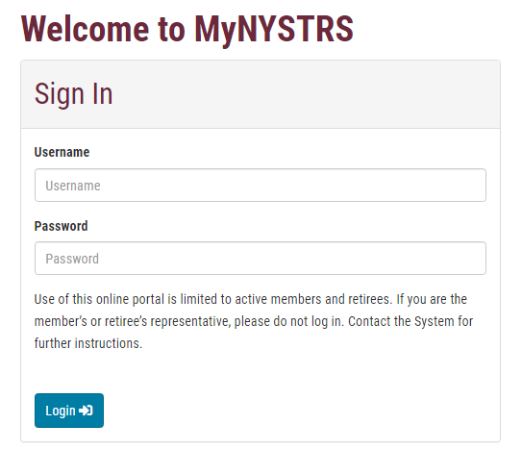
Sign Up For MyNYSTRS!
Fastest and easiest way to do many of the transactions we will discuss today
Secure
Communicate with NYSTRS via Secure Messaging
Update beneficiaries & file both Service and Disability Retirement Applications
Notes:
The first thing I would tell a member if I received an inquiry is to sign up and register for a MyNYSTRS account. I know we sing MyNYSTRS praises a lot, but with the time sensitive nature of death and disability having an online account already established or getting one set up quickly may be the difference of your beneficiaries being better protected in the event of your illness or passing. Please encourage your colleagues to create an account if they do not already have one as it is the fastest and easiest way to complete a host of transactions. It is a secure portal where you can conduct business with the retirement system. is a safe way of complete beneficiary designations and filing applications for service or disability retirement.

Slide 7
Disability Retirement Eligibility Tiers 3-6
Have an active membership with at least 10 years of NYS service credit*
Be totally and permanently incapacitated from all further gainful employment at the time you cease teaching
Apply for disability retirement within one year of leaving payroll (If you are on a medical leave without pay, you may file within a year of the date your medical leave ends)
Continue to be disabled from all gainful employment
Have the NYSTRS Medical & Retirement Boards approve your retirement.
Notes:
To qualify for a disability retirement if you are a member in tiers 3-6 you must have an active membership with at least 10 years of service. You must be totally, permanently and continuingly incapacitated from all further gainful employment and you must apply for disability retirement within on year of leaving payroll and provide medical evidence to the extent of your And finally, your application must be approved by NYSTRS medical and retirement boards. And unlike a service retirement which requires you to be 55 in order to start collecting the benefit you can apply no matter what your age is you have met the eligibility requirements. There have been instances where NYSTRS has been contacted by a member who has been off of payroll for more than a year due to no longer being able to work, usually because they just did not know that they could apply for disability, and they find themselves not eligible. This is another reason it is so important that members have the knowledge that this benefits are available, so they do not miss their window of opportunity to apply.

Slide 8
I’m a Tier 1 or 2 should I file for disability retirement?
No, a service retirement would be better.
Notes:
Today you will notice that I am speaking mostly to and about members who are in Tiers 3-6 regarding disability benefits. That is due to the fact that for any currently working Tier 1 or 2 members which isn’t too many at this point, they would not want to consider a disability retirement, even if you are no longer able to work as their current service retirement calculation would be better.

Slide 9
How much does a disability retirement pay?
A disability benefit generally equals 1/3 or 33.33% of your Final Average Salary, but the benefit can depend on your age and service credit.
Benefits are paid monthly on the last business day of each month.
Notes:
So how much does a disability pension pay? A disability benefit generally equals 1/3 or 33.3% of your Final Average Salary, but the benefit can depend on your age and service credit. Your final average salary is generally the average of your three highest consecutive years of earnings. Benefits are paid on the last business day of each month via direct deposit. You will provide your banking information at the time you submit your application.

Slide 10
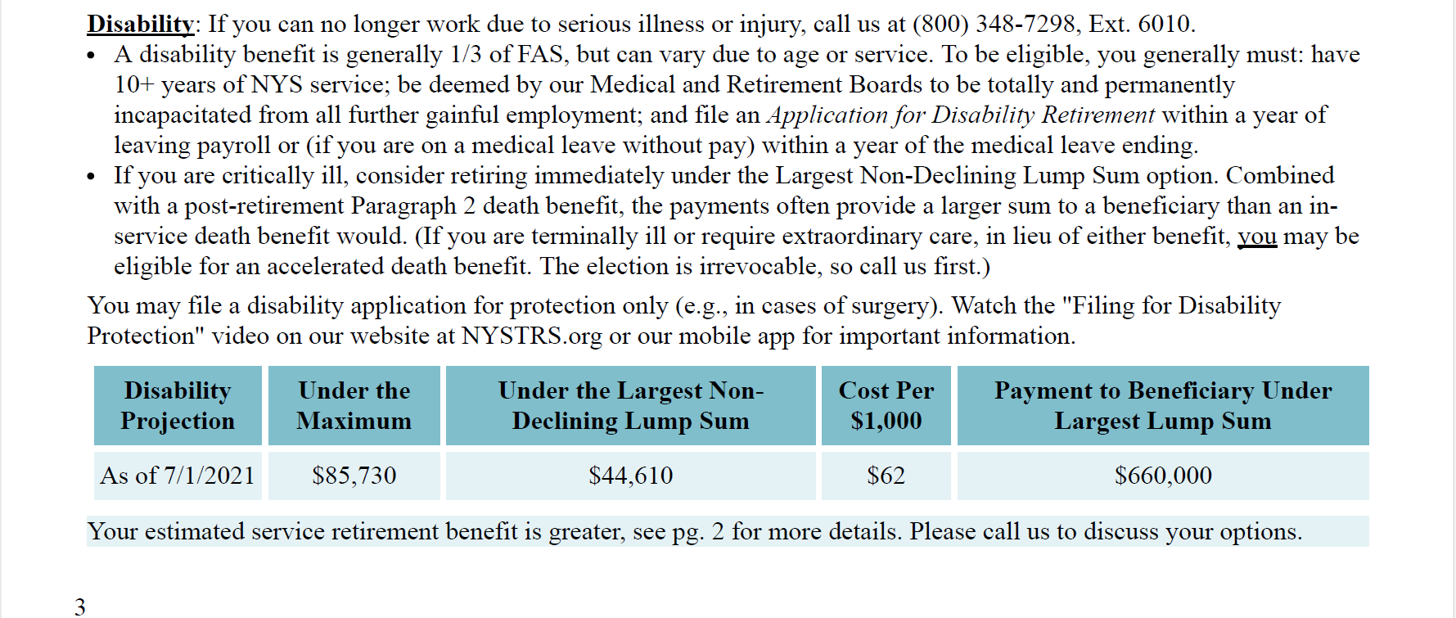
Where can I find more information?
7/1/2025
Notes:
Where can you find more information regarding disability benefits? If a member were to call and inquire about a disability pension, I would ask if they had their annual benefit profile handy, and if so I would guide them to page three and as long as they had enough years of service the profile will provide a disability pension projection. We then would discuss the projection and if the member decides I would then let the member know how to apply for a disability retirement.

Slide 11
Applying
Online using your MyNYSTRS account
Fill out a paper Application for Disability Retirement* (RET-54.1) and submit by U.S. mail or fax.
Notes:
The best way for a member to apply is online using their MyNYSTRS account as it ensures the application is completed correctly before it can be submitted. Alternatively, a paper Application for Disability Retirement can be filed by mail. All of NYSTRS forms can be found on our website or be mailed to you.

Slide 12
What medical documentation will I need to submit?
You and your physicians play a vital role during the processing of your application. Our Medical Board requires evidence of the extent of your disability.
Complete the MEDICAL INFORMATION SUMMARY
(RET-54.1B)
Notes:
What medical information will need to be submitted? You and your physicians play a vital role during the processing of your disability application. Our Medical Board requires evidence of the extent of your disability and you have the burden of providing such evidence. In the retirement application you will fill out a medical information summary, you will list the physicians consulted in connection with your illness that you would want to fill out a medical report on your behalf.

Slide 13
What medical documentation will I need to submit?
You must also complete Part 1 of the Medical Report (RET-54.3) and give one to each physician involved in your care as soon as possible.
Notes:
You must also complete Part 1 of the Medical Report (RET-54.3) and give a form to each physician involved in your care as soon as possible.

Slide 14
What Option should I choose for my Disability Retirement?
There is no one-size-fits-all benefit choice.
Review the features each choice provides, consult with your family or financial advisor or review your options with a NYSTRS representative.
See our publication “Maximum or an Option: Choosing a Benefit Payment Right for You”
Notes:
When you retire, whether that be for a service or a disability retirement you must decide whether to reduce your pension from the Maximum benefit to set aside money for a beneficiary upon your death. This election cannot be changed more than 30 days after your retirement date, so it is imperative to analyze the choices carefully. Consider the health, age, and financial needs of you and your beneficiary(ies), as well as your life insurance coverage or other income sources. There is no one-size-fits-all benefit choice. You have all the same options under a disability retirement that you would if you file for service retirement. Your option choices will be listed as part of any estimate NYSTRSs makes available to you. You will want to review the features that each choice provides and consult with your family or financial advisor or review your options with a NYSTRS representative.
You can also see our publication “Maximum or an Option: Choosing a Benefit Payment Right for You”. This guide provides a breakdown of each option, its features and who would want to consider each option.

Slide 15
Largest Non-Declining Lump Sum Option
A payment lower than the maximum benefit, paid for your life.
You can name more than one beneficiary and change your beneficiaries at any time.
Are a Tier 2-6 member who is critically ill, and you want to provide a fixed lump sum payment to a beneficiary.
Desire a lump sum payment to a beneficiary but are unable to obtain sufficient private life insurance.
If you are critically ill, you may want to select in case you pass away while your Disability Application is under review.
Features
&
Things to Consider
Notes:
No matter which option you elect you will receive monthly benefits for life. You can choose any option you are eligible for but if you are critically ill, you may want to select the largest non-declining lump sum in case you pass away while your Disability Application is under review. This would provide the largest possible sum to your beneficiaries. The largest non-declining lump sum is
A payment lower than the maximum benefit but is still paid for your life.
You can name more than one beneficiary and change your beneficiaries at any time.
This would also be an option to consider if you are unable to obtain sufficient private life insurance.
Just as a personal example I had met with a member who really wanted to continue working despite their disability through the end of the school year as she did not want to leave her students mid year. However, her illness had come to a point that her doctors really did not think she would be capable much longer, and after speaking with her family she decided to file for disability retirement. This allowed her to chose a lump sum payment for her children as her and her husband did not have any other assets that the children would stand to inherit. While she was devastated to leave her job, she retired with peace of mind that if she did pass away because of her illness that caused her disability that she could set her children up for the future. This is why I take such pride in the work that I do as a NYSTRS representative because we can provide outcomes that really help our members. As a delegate you can also help your fellow collegues by letting them know that NYSTRS is here to help.

Slide 16
Service vs. Disability
$65,600
$799,850
7/1/2025
$67,070
$513,400
Notes:
You may also want to consider whether a disability or a service retirement would better meet your needs. This slide is showing a comparison of a members disability retirement projection to their service retirement projection from their benefit profile. The members benefit under a disability retirement is $67,070 per year vs $65,600 per year under a service retirement. Under the maximum option a disability retirement would pay more annually.
So if this member did not need to leave any money to a beneficiary from the pension a disability retirement would pay the member more while they were living.
However, look at the largest non declining lump sum payment under the service retirement compared to the disability retirement. Under a service retirement the beneficiary would stand to receive almost $800,000 vs. $500,000 under disability.
This is due to the actuarial factors used to calculate the benefit. So if this person really wanted the largest non-declining lump sum to protect their beneficiary then the member would be better off with a service retirement.
This is also why its imperative for someone facing a disability retirement to call the retirement system so we can review their file and guide them to make a decision that works best for them or there loved ones.

Slide 17
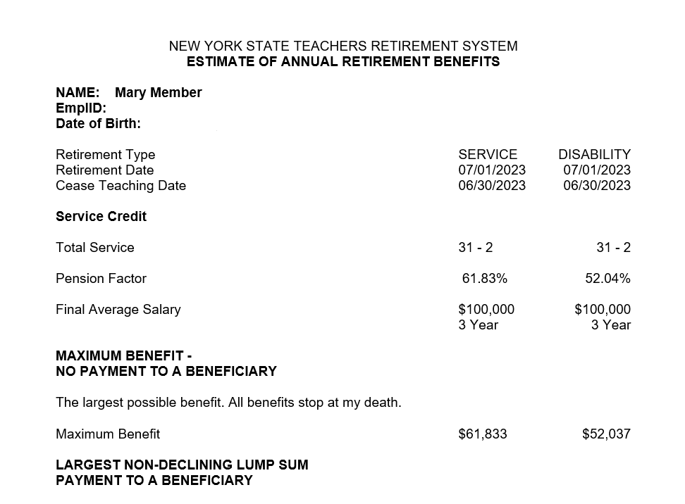
What if a member is close to 55?
12/13/1965
12/11/1965
7/1/2025
7/1/2025
$61,833
$52,037
Notes:
Also, If you are close or over the age of 55 and are considering a disability retirement. You want to be careful about whether you chose to apply for disability or a service retirement. There are times where depending on your age and years of service, that a service retirement may be better. You will certainly want to contact the retirement system so we can run a comparative estimate to ensure you are going down the path that best service you and your beneficiaries. For example in this pension projection for a member who happens to be over the age of 55 and has over 30 years of service the members service retirement would pay more than the disability retirement would, so there would be no need to file for disability retirement. We certainly do not expect you to be able to make these comparisons and judgments yourself so again, reaching out to NYSTRS is vital.

Slide 18
After I submit the application, what happens next?
Once we receive your medical records stating you are no longer able to work, we will present your file at the monthly meeting of our Medical Board.
You will be notified if your application has been approved or denied.
Notes:
After you apply and submit your application what happens next? Once we receive your medical records provided they state you are no longer able to work we will present your file at the monthly meeting of our Medical Board. You will be notified if you application has been approved or denied.

Slide 19
What if I want to change my option after approval?
NYSTRS must receive your
Election of Retirement Benefit (RET-54.6)
within 30 days:
After the date the retirement becomes effective,
or
After Medical Board approval,
whichever is later.
After that 30-day period, the election is irrevocable.
Can be filed online or by paper form.
Notes:
Once approved, if a member wishes to change their option election, NSYTRS must receive an Election of Retirement benefit within 30 days after the retirement becomes effective or after medical board approval whichever is later. Once that 30 days has passed the option choice is irrevocable. The election can be filed online or by paper form.

Slide 20
What if I pass away during the process?
Retirement benefits will be paid if:
You filed and qualified for a disability retirement; and
You selected the Largest Non-Declining Lump Sum Option under Tier 2-6 and
The illness specified on the application is related to the cause of death.
Notes:
Members sometimes will ask what happens if they pass away during the disability retirement process? NYSTRS will pay benefits
if you filed and ultimately qualified for disability retirement
and selected the largest non-declining lump sum option
and if your passing was because of the illness specified on the application.

Slide 21
Can I still work while collecting a disability pension?
If you are in Tiers 3-6, you cannot work while collecting a disability pension due to having to be completely incapacitated from all gainful employment either physically or mentally to qualify.
Notes:
Can you still while disability pension. Members are not able to continue any employment while collecting a disability pension due to having to be completely incapacitated from all gainful employment either physically or mentally to qualify.

Slide 22
What if I have an outstanding loan?
If you wish to repay all or a portion of any outstanding loan prior to retirement, NYSTRS must receive the payment within 30 days following approval of your effective date of retirement.
If you are a Tier 3-6 member and do not repay your loan, your lifetime benefit will be reduced, and the outstanding loan will likely be a taxable distribution.
Notes:
And what if you have an outstanding loan. If you wish to repay all or a portion of any outstanding loan prior to retirement, NYSTRS must receive the payment within 30 days following approval of your effective date of retirement.
If you do not repay your loan, your lifetime befit will be reduced, and the outstanding loan will likely be a taxable distribution.

Slide 23
Is a disability pension taxable?
Just like a service retirement, a disability retirement is subject to federal tax but is exempt from NYS tax.
Notes:
And is a disability pension taxable. Yes, just like a service retirement, a disability retirement is subject to Federal Tax but is exempt from NYS tax. You will fill out a W4P form to have taxes withheld from your monthly benefit and you will receive 1099-R each January to file your tax return with.

Slide 24
If I become incapacitated can someone file for disability on my behalf?
If you have a valid Power of Attorney on file with NYSTRS.
A POA allows you to designate someone else, referred to as your “agent” to act on your behalf with or without your consent.
However, use of MyNYSTRS is only for members and should not be used to submit a Disability Retirement Application.
Notes:
So a questions I get asked about a lot is what if the member is incapacitated and cannot act on their own behalf, can someone else apply for disability for them? The answer is yes but you must have a POA. A Power of Attorney (POA) is a powerful document. It allows you to designate someone else, referred to as your “agent,” to act on your behalf with or without your consent. NYSTRS accepts New York State POAs, Out-of-State POAs and the Public Retirement System Special Durable Power of Attorney (Special POA). Form which can be found on our website.
Keep in mind while you are able to file the application online as a member, a POA or any one other than the member is prohibited from using MyNYSTRS, so paper applications must be received.

Slide 25
What does a Power of Attorney do?
Allow one or more people you trust to manage financial matters while you are still alive.
You retain ability to act on your own behalf.
May remain effective even if you become incapacitated (Durable).
Notes:
And what does a power of attorney do
Allow one or more people you trust to manage financial matters while you are still alive.
You retain ability to act on your own behalf
May remain effective even if you become incapacitated (Durable)

Slide 26
What can you authorize your agent to do on your behalf with a POA?
Standard Authority
Allows your agent to access to:
account-specific information;
update address/phone;
take a loan;
change direct deposit to an account solely owned by you;
apply for retirement benefit; and
change a tax withholding.
Gifting Authority
Allows your agent to:
change our direct deposit to a joint bank account;
elect a pension payment option that provides for a beneficiary;
designate or change death benefit beneficiaries; and
name the agent themselves as beneficiary if “self gifting” is granted
You may grant your agent Standard Authority and Gifting Authority.
Depending on the level of authority granted, at NYSTRS your agent will be able to conduct the following transactions.
Notes:
What can you authorize your agent to do on your behalf. You may grant your agent Standard Authority and Gifting Authority.
Depending on the level of authority granted, at NYSTRS your agent will be able to conduct a host of transactions. Gifting authority allows your agent to elect a pension payment option that provides for a beneficiary. This is something that comes up pretty often. Recently I spoke to a members power of attorney and while they were able to file a disability retirement application on behalf of the member as they were unfortunately in the hospital and not able to file themselves, the power of attorney did not grant gifting authority so the spouse was unable to chose a lifetime survivor benefit for themselves. So gifting authority is important if you want your agent to be able to select a pension option that provides for a beneficiary if you are unable to.

Slide 27
Special Durable Power of Attorney
The Special POA allows an agent to act on your behalf with respect to your retirement transactions at NYSTRS and other NYS public retirement systems.
This POA does not grant authority for any other legal transactions.
Notes:
Because NYSTRS encourages all members to have a POA on file, if you do not have POA but would like to we offer a Special Durable Power of Attorney for retirement transactions only, this form can be found on our website. Once executed you would send this to the retirement system to be kept in your file, so that if your POA ever needs to they can act on your behalf with respect to just retirement transactions.

Slide 28
Estate Planning
It is never too early
Coping with the passing of a loved one is difficult enough; dealing with estate issues can make it much harder. You can help your family settle your estate by organizing your important legal and financial statements with our estate planning list.
You can find this estate planning list on our public website.
Attend a PREP seminar as there is an entire module on estate planning.
Notes:
Enacting a power of attorney can be part of your overall estate planning. We encourage you to start planning as it is never too early. NYSTRS provides an estate planning list on our website to help your family settle your estate by organizing your important legal and financial statements. Your family will thank you. I am hoping that you all were able to attend yesterday's presentation on estate planning! It certainly motivated me to think and plan ahead. If you did not get to see it you can always attend a PREP the Pension and Retirement Education Program seminar that NYSTRS offers as there is an entire module on estate planning.

Slide 29
Disability For Protection Only
Notes:
Next I want to discuss with you benefits you have under what we call “disability for protection only”

Slide 30
What if I have a critical illness or am having surgery?
Considering filing a disability retirement for protection only.
Doing so provides an important safety net for you and your beneficiaries.
Notes:
If you have been diagnosed with a life-threatening medical condition, critical illness or are having surgery, considering filing a disability retirement for protection only application.
Doing so can provide an important safety net for you and your beneficiaries.

Slide 31
What does Disability For Protection Only Provide?
Your beneficiary(ies) may receive the Largest Non-Declining Lump Sum benefit and 50% of the member’s Paragraph 2 Death Benefit.
This is typically more than the beneficiary would receive for an In-Service Death Benefit.
Notes:
What exactly is the benefit of filing for protection only? If you were to pass away due to your critical illness or surgery your beneficiary would stand to receive a significantly higher payment than just the in service death benefit( which typically pays approximately 3x your salary). This could make a huge difference in the lives of your beneficiaries and give you peace of mind that you are protecting your beneficiary's the best way you can.

Slide 32
How much of a difference can it make?
In Service Death Benefit $75,000 x 3 = $225,000
Contributions$35,000
Total Payment to Beneficiaries
$260,000
Member’s Salary= $75,000
Notes:
I will have to get ahead of myself in order to provide a true example of how filing disability for protection only can pay significantly more than the in service death benefit. So lets say hypothetical if a member passes while in service from an illness and their salary is $75,000 we would pay their beneficiary three times that amount for the in service death benefit, we would also refund the members contributions of $35,000. So the total payment to the beneficiary upon the members passing would be $260,000.

Slide 33
How much of a difference can it make?
Largest Non-Declining Lump Sum
=$300,000
50%
In Service Death Benefit
=$112,500
Total Payment to Beneficiaries
=$412,000
Filing for Disability for Protection Only
Notes:
So how much of a difference can filing for disability for protection only make? If the member files disability for protection only and they pass away as a result of the illness not only would we pay the largest non-declining lump sum as selected but the beneficiary would also be paid 50% of the in-service death benefit for a total payment of $412,000, $152,000 more than if the member did not file for protection. This benefit is probably the one members know least about, so when I have had the conversation with members about putting this on file it gives me great satisfaction when the member is able to leave over a hundred thousand dollars more to their beneficiary.

Slide 34
How do I file for Disability for Protection Only?
To file for protection, you may use the online disability retirement application in your secure MyNYSTRS account under the My Retirement tab.
Alternatively, you can complete the Application for Disability Retirement (RET-54.1) and Medical Information Summary (RET-54.1B).
Notes:
So how does one file for disability for protection only? You can file either online using your mynystrs or by paper form. All of our forms again are available online or be mailed to you.

Slide 35
How do I file for Disability for Protection Only?
“For Protection Only”
Clearly write “For Protection Only” on the application.
Indicate the medical condition necessitating the protection.
Leave the date of retirement blank
Select the Largest Lump Sum Option
Notes:
If you file paper application you must clearly write “For Protection Only”, indicate the medical condition necessitating the protection. You will leave the date of retirement blank and select the Largest Lump Sum Option.

Slide 36
How do I file for Disability for Protection Only?
Have signature notarized prior to mailing
You must also complete the Medical Information Summary.
Send by fax or U.S. mail
Notes:
You will need to have the application notarized, complete the medical information summary and then mail or fax the form to NYSTRS. NYSTRS will keep your election on file and if the condition necessitating the protection persists, we will follow up with you yearly.

Slide 37
What if the situation changes??
Withdraw
Pursue Disability Retirement
.
Notes:
But what if the situation changes? If your condition improves you can withdraw your for protection only application by submitting the withdrawal in writing.
Or you can pursue disability retirement, in which you want to contact the retirement system for your next steps.

Slide 38
Why apply?
Simply, NYSTRS would pay your beneficiary more than the in-service death benefit if you pass away from the illness or surgery necessitating protection.
Notes:
Just to reiterate why a member would file for protection only, it is because your beneficiary would be paid more than the in service death benefit if you pass away from the illness or surgery necessitating protection. We have had many members choose this, and it really makes them feel like while they may not have control of the medical issues that are impacting them but having the ability to take control of providing more to their beneficiary can bring them great comfort and peace of mind.

Slide 39
Death Benefits
Active & Retiree
Notes:
Next I want to discuss with you benefits you have under what we call “disability for protection only”

Slide 40
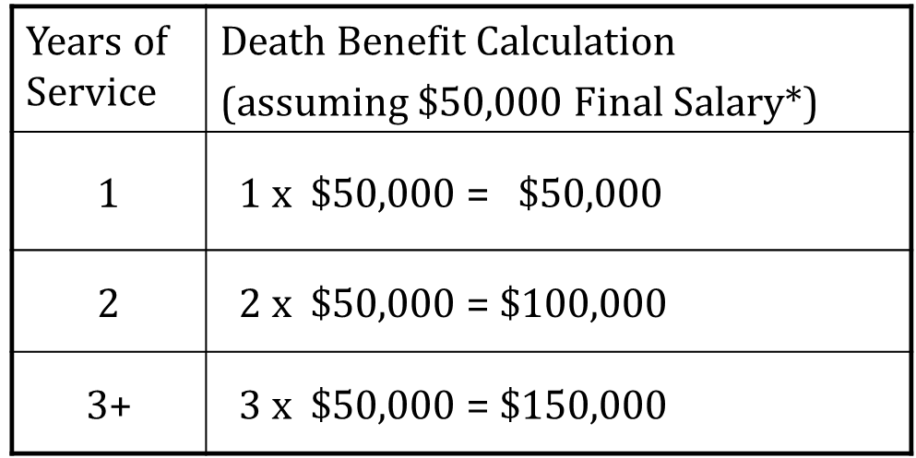
Paragraph 2 In-Service Death Benefit (Tiers 2-6)
Service
(Up to 3 years)
X Final Salary*
Maximum Reduction of 40%
Lump sum reduced 4%
per year
62 for Tier 2-5 63 for Tier 6
Notes:
The death benefit that many of you are already covered by is called our Paragraph 2 In Service Death Benefit. once you have 3 or more years of service if you were to pass away while still actively working we would pay your beneficiary approximately 3x your final salary as stated before. If you are over the age of 62 in tiers 3-5 and at age 63 in tier 6 and still working your death benefit is reduced by 4% per year for a maximum reduction of 40%. There is a cap on the maximum amount of salary considered for calculating the death benefit. Review your Benefit Profile, available online to those with a MyNYSTRS account, for the amount specific to you. In the event of your passing while in service we would also issue a refund of your contributions.

Slide 41
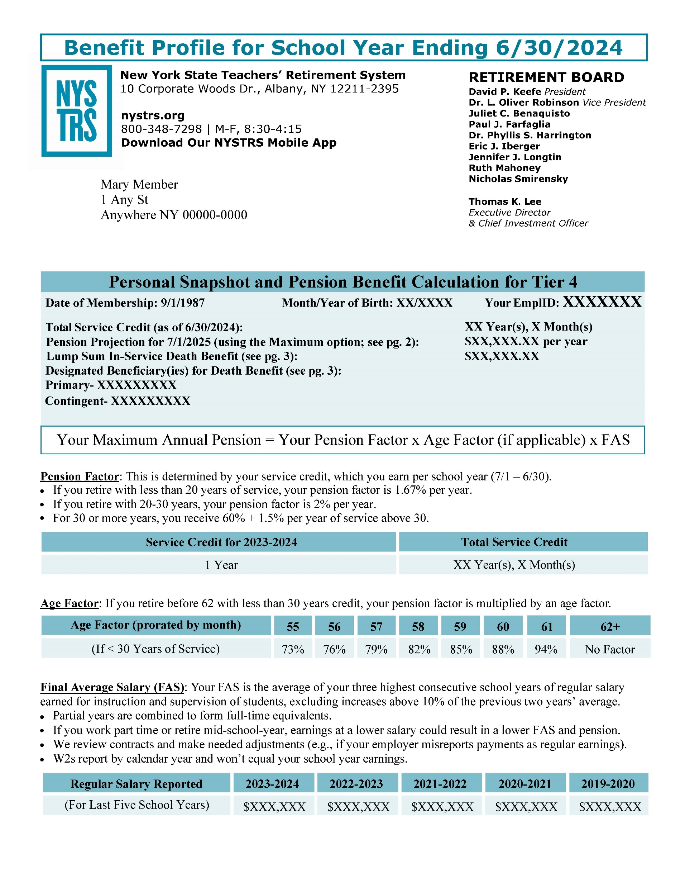
Where can I find my death benefit information?
Notes:
Where you can you find your death benefit information. Review your Benefit Profile, available online to those with a MyNYSTRS account, for the amount specific to you.You can find your death benefit information in your annual benefit profile. The 2024 benefit profiles will be distributed later this November. If you had a full year of service credited you will find the current lump sum in service death benefit listed along with your named beneficiaries. Keep in mind that if you or a colleague are part time or for some reason worked less than 170 days this past school year you may not have an in-service death benefit published in the profile. That does not mean that you are not eligible. Also, keep in mind your benefit profile is a static document so if you made changes after the publishing of the document it will not be reflected. However, your online MyNYSTRS will provide you with your current designation in the “Beneficiaries” Section.

Slide 42
If an active member passes away:
Please notify NYSTRS by calling (800) 348-7298, Ext. 6110, or instruct the members family to do so.
The member’s named beneficiary(ies) will receive the eligible member’s In-Service Death Benefit and the member’s contributions balance.
Notes:
If an active member passes away NYSTRS should be notified by the family, next of kin or school district. From there we will contact any an all beneficiaries with a request for a certified death certificate and paperwork to initiate death benefit payments if eligible.

Slide 43
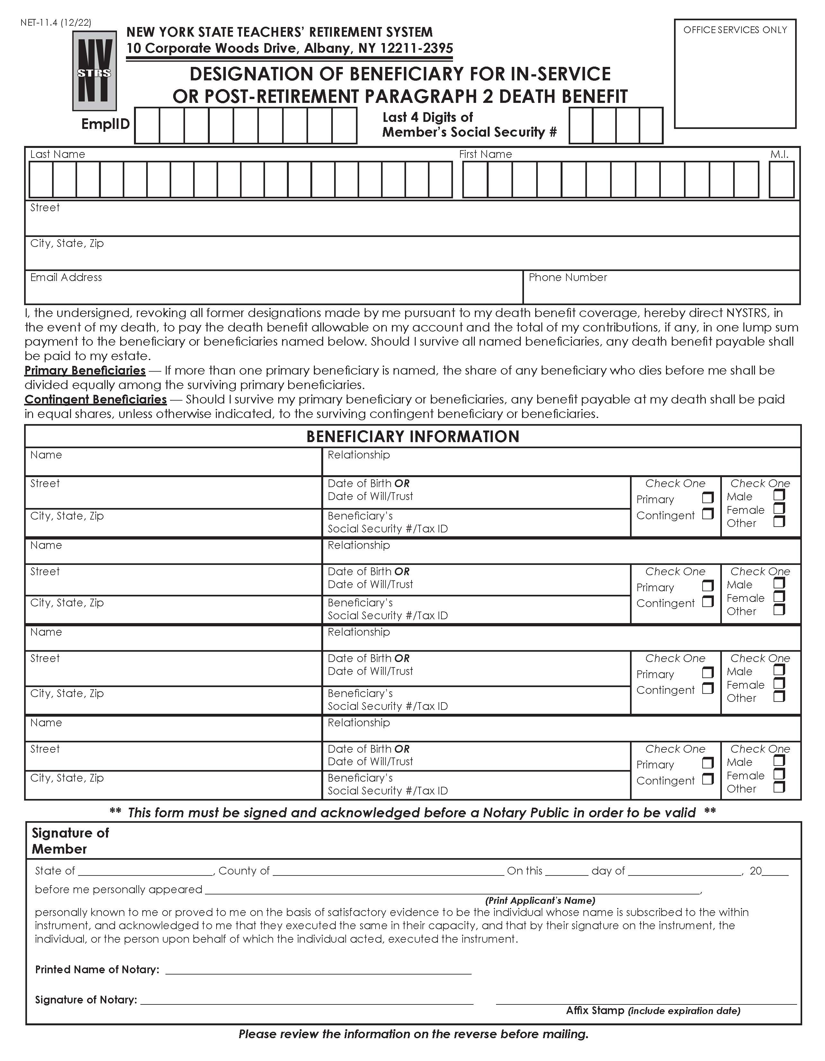
Death Benefits: Updating your Beneficiary
Review your beneficiary information and file a new form as needed.
You may list primary and contingent beneficiaries.
Changes can be made throughout your active career and your retirement.
Submit a new beneficiary designation online through MyNYSTRS or send a notarized paper form. Designation of Beneficiary for
In-Service or Post-Retirement Paragraph 2 Death Benefit (NET-11.4).
Notes:
As life changes occur it is extremely important that you keep your beneficiaries up to date as NYSTRS can only pay the person you have named as beneficiary. You may have named your parents as beneficiary when you first started teaching but you’ve since gotten married or had children, so its important that you take a look and ensure the beneficiaries named are who you would like to be paid uYou may have both primary and contingent beneficiaries. You can make changes online using your MyNYSTRS account or by filing a paper designation.

Slide 44
Vested Death Benefit
If you have at least 10 years of service credit but have not yet retired and do not meet the eligibility requirements of any other NYSTRS death benefit.
You would be eligible for a vested death benefit.
Notes:
If a member stops working in a title reportable to NYSTRS and has at least 10 years of service credit but has not yet retired they are eligible for a vested death benefit. This usually comes into play if a member has a ceased teaching and career change. If the member passes away before they had the opportunity to retire NYSTRS would pay 50% of the in service death benefit that would have been payable if your death occurred on the last day of service. We would also refund contributions

Slide 45
Accelerated Death Benefit
This election is irrevocable
It would equal the death benefit paid if you passed away on the last day of reportable service.
You have a terminal illness resulting in life expectancy of no more than 12 months, or
You have a medical condition requiring extraordinary care or treatment.
You qualify for Disability Retirement
Notes:
There is also an accelerated death benefit option that you can receive while you are still alive if you qualify for a disability retirement, and meet one of the following requirements:
either You have a terminal illness resulting in life expectancy of no more than 12 months, or
You have a medical condition requiring extraordinary care or treatment.
This election would be irrevocable and the payment is made one time only in lieu of any monthly retirement benefit and any death benefit paid to a beneficiary.
It would equal the death benefit paid if you died on the last day of reportable service.

Slide 46
Accidental Death Benefit
Accidental Death Benefit
Pays approximately 50% of your salary depending on tier of membership
Benefits are paid to beneficiaries in the following order:
Surviving spouse until remarriage;
Children until age 25;
Dependent parents;
Dependents under last income tax return until age 21.
Notes:
You may be eligible for an accidental death benefit if you die in service because of an accident in the performance of your duties.
It would pay an annual Approximately 50% of your salary depending on tier of membership
Surviving spouse until remarriage;
Children until age 25;

Slide 47
Tiers 2-6 Post- Retirement Death Benefit
First Year | 50% of the death benefit in effect at retirement
Second Year | 25% of the death benefit in effect at retirement
Third and Ensuing Years | 10% of the benefit in effect at retirement, or age 60 if higher
May be eligible if you retire within a year of leaving payroll
Avoid non-NYSTRS employment between ceased teaching date and retirement date
Tier 1 members are not eligible
Notes:
Your in service death benefit does follow you into retirement but at a reduced rate. As long as you retire within a year of leaving payroll and avoid any non-nystrs employment between your ceased teaching date and retirement date we would pay your beneficiaries 50% of your in service death benefit if you passed away in the first year of retirement, if you pass in year two of retirement we would pay 25% of your in service death benefit and then in year three or any year that you pass away thereafter NYSTRS would pay 10% of your benefit in effect at retirement or at age 60 if that is higher. Once retired, each year you will receive a retired member profile which will list the amount payable and your beneficiary information.

Slide 48
In-Service Death Benefit= $225,000
Third Year and Beyond
=$22,500
Second Year=$56,250
First Year=$112,500
Notes:
So for example if a member salary is $75,000 and they qualified for an in service death benefit we would pay $225,000 but then once the member retires in year one we’d pay 50% of the in service death benefit $112,500, year two we’d pay $56,250 and then in year three or any year after it be $22,500. So this is a substantial benefit that you have as retirees at no cost to you.

Slide 49
Are death benefit payments taxable?
The first $50,000 of the employer- funded death benefit is considered group term life insurance for tax purposes and is not taxable.
Lump sum payments of an employer-funded death benefit (as defined above) more than $50,000 are fully reportable as taxable federal income.
Can be rolled over into IRA or another qualified plan*
All payments from this System are specifically exempt from New York State income tax.
Notes:
Are death benefit payments taxable? The first $50,000 of the death benefit is considered group term life insurance for tax purposes and is not taxable.
lump sum payments of an death benefit of more than $50,000 are fully reportable as taxable federal income.
However the payment can be rolled over into IRA or another qualified plan*
All payments from this System are specifically exempt from New York State income tax.
In January of each year the System will mail an IRS Form 1099-R to all beneficiaries who received a payment in the previous calendar year.

Slide 50
If a retired member passes away:
The beneficiary/family should call NYSTRS at (800) 348-7298, Ext. 6140 to report the death. This will ensure the beneficiary(ies) receives any promised benefits in a timely manner.
An original or certified copy of the death certificate will need to be submitted to NYSTRS.
The beneficiary should also contact the retiree’s former employer, which may have provided health insurance.
Notes:
And finally, just like when an active member passes away if a retiree passes away NYSTRS should be notified by the members family or beneficiary. They may also need to contact the former employer if health insurance was provided in retirement. We will ask that a death certificate be sent in and any paperwork that needs to be filled out to claim the death benefit will be sent to the beneficiary.

Slide 51
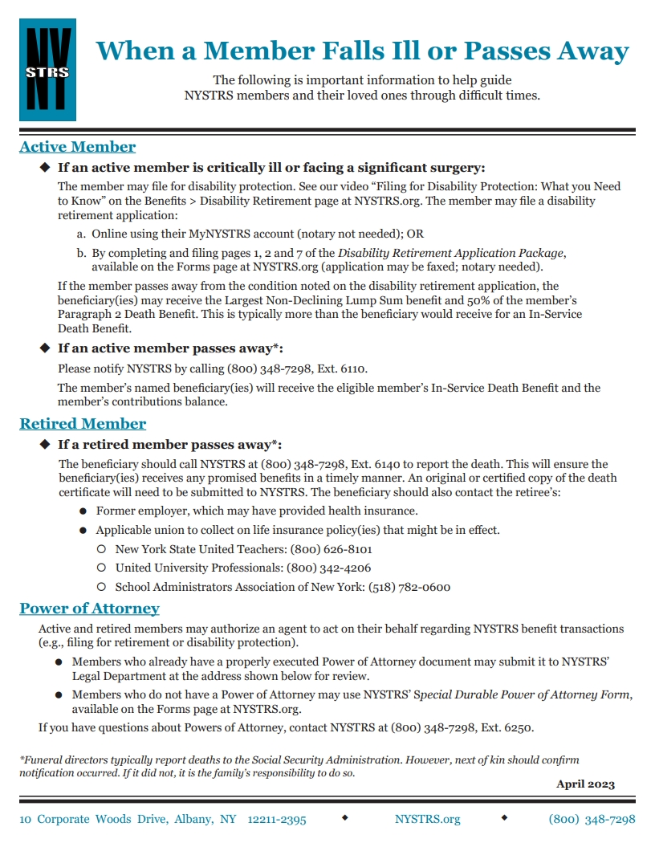
Takeaways
Keep your beneficiaries up to date.
You can help your colleagues!
Have a power of attorney, but understand it is a powerful document.
Refer to the document When A Member Falls Ill or Passes Away.
Call NYSTRS (800) 348-7298, we are here to help.
Notes:
I know these topics can be heavy and difficult to think about, so I appreciate you all bearing with me. Some key takeaways from todays presentation, is to first keep your beneficiaries up to date, realize you have the power as a delegate to help your fellow colleagues during their times of need. They may approach you since you are a liaison to the retirement system to help them navigate illness and their pension. Again, we do not expect you to have all the answers for each individual situation that may present itself. Having the awareness that the benefits we have discussed today exist, but certainly defer to the retirement system for specific questions. This presentation will also be made available online after the conclusion of the delegates meeting. Please also, refer your colleagues to our publication When A Member Falls Ill Or Passes Away this is a helpful guide to members and their loves ones through difficult times. This can be found on our website. Remember that when you or a colleague is facing a critical illness or surgery to apply for protection only as it can pay hundreds of thousands dollars more than an inservice death benefit if you pass away of that illness like in our example. Also, Utilize a power of attorney but realize that it is a powerful document.
NYSTRS vision is to be the model for pension fund excellence and exceptional customer service so please reach out to us with any questions or concerns, especially if you are facing an illness or disability.
Thank you very much for the opportunity to present for you today, and we hoped that you enjoyed this year delegates meeting, See you next year!

